Slide 1
Battle of the Businesses in a Neighborhood
Applied Data Science Capstone Project
By Rohan Loke

Slide 2
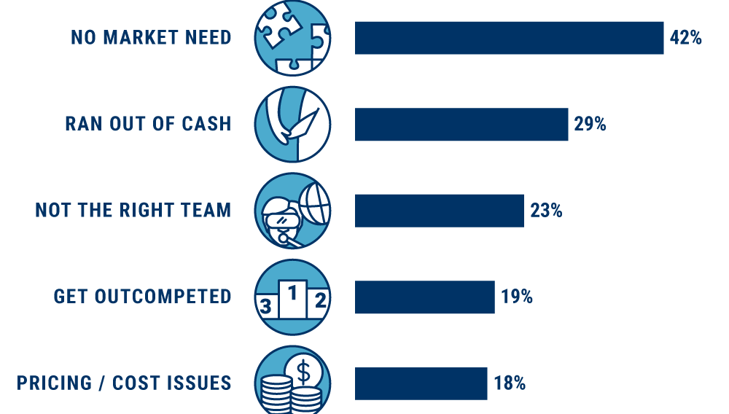
Why is it important to analyze different factors before starting a business
New start-ups pop up every day all around the world, each of them hoping to get acquired by a larger company or make it big in their own right
There are thousands which fall into obscurity
The following picture shows the reason for which the startups fail and the top reason is “No market need”.
To avoid this analysis is necessary
Image source : https://www.cbinsights.com/research/startup-failure-reasons-top/

Slide 3
Introduction to the project
Building a model to determine best local business to start in a popular Neighborhood
In addition to this, model also provides with most competitive and least competitive business
In this project I am going to explore top -3 local businesses in the city of Toronto (as an example).
It will help the business owners to analyse which location is best for which type of business
The business owners can select whether they want to start a business which has huge competition because it is popular business or they want to start a business which has less competition and gain competitive advantage

Slide 4
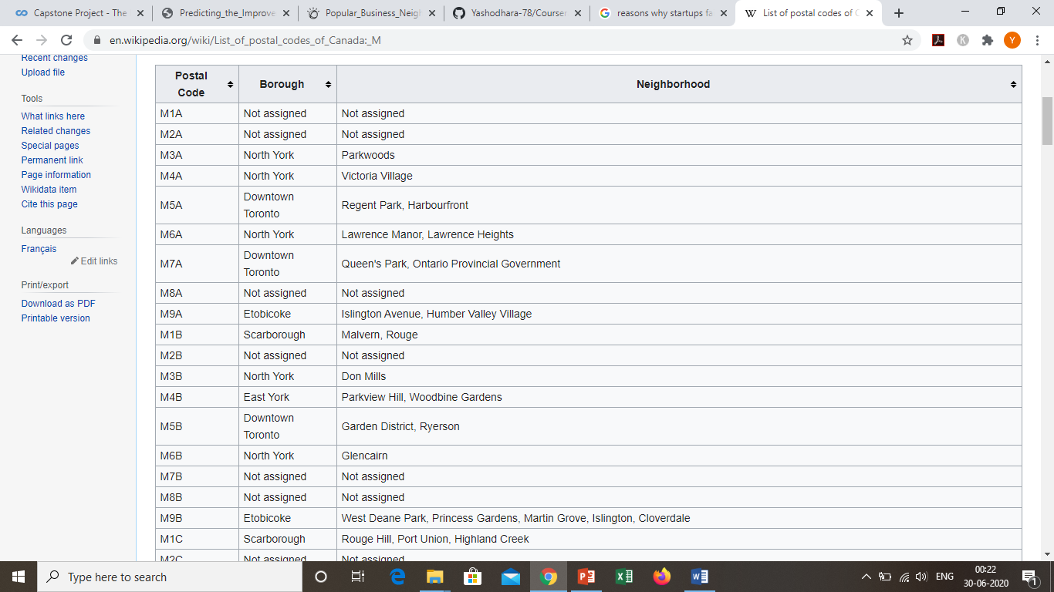
Data Acquisition
The data for “Toronto” was found on Wikipedia and the table was scraped
Also the “Geospatial_Coordinates” data was used which was obtained during the course period. These 2 datasets were used in the model.
Data source : https://en.wikipedia.org/wiki/List_of_postal_codes_of_Canada:_M

Slide 5
Data Cleaning
Data downloaded or scraped from multiple sources were combined into one table. There were a lot of missing values in the Toronto dataset. I decided to drop the values where Borough were ‘Not assigned’ and mask the Neighbourhood where values were ‘Not assigned’.
Second, multiple entries existed for similar Postal Code with different neighbourhoods. This cause their data to represent multiple samples with incomplete data. I wrote script to extract the unique Postal Code, I grouped the data according to the ‘Postal Code’ and ‘Borough’.
Now I wanted to merge the Toronto dataset with the Geospatial_Coordinates. To do this I merged them on the basis of ‘Postal Code’.

Slide 6
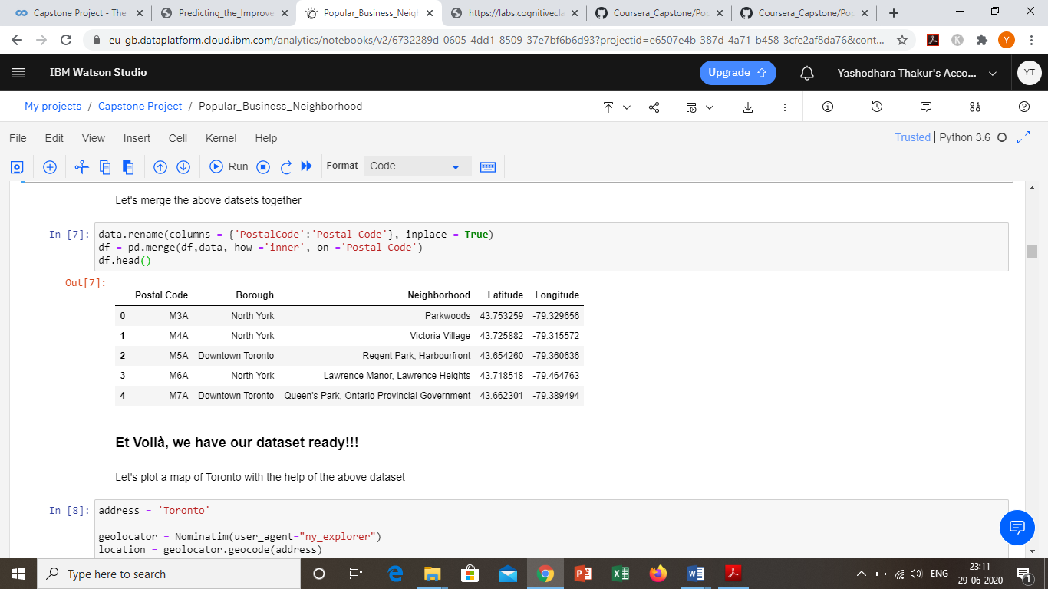
After cleaning and merging the data

Slide 7
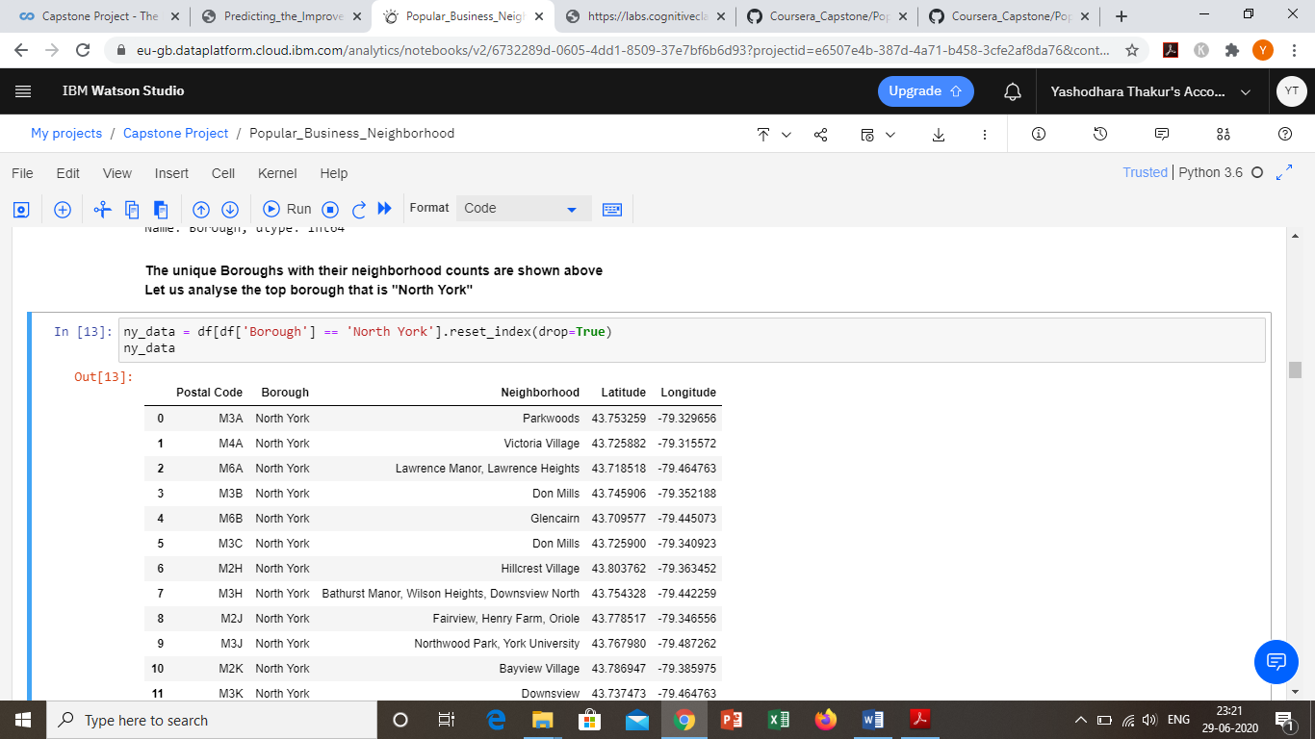
Data Analysis
During this analysis I found out that there were 10 boroughs and 103 neighbourhoods
Further analysing the data I found that “North York” was the top borough of all because it had the maximum neighbourhoods than all.
Then I created a dataset which consist of only “North York” data as the below

Slide 8
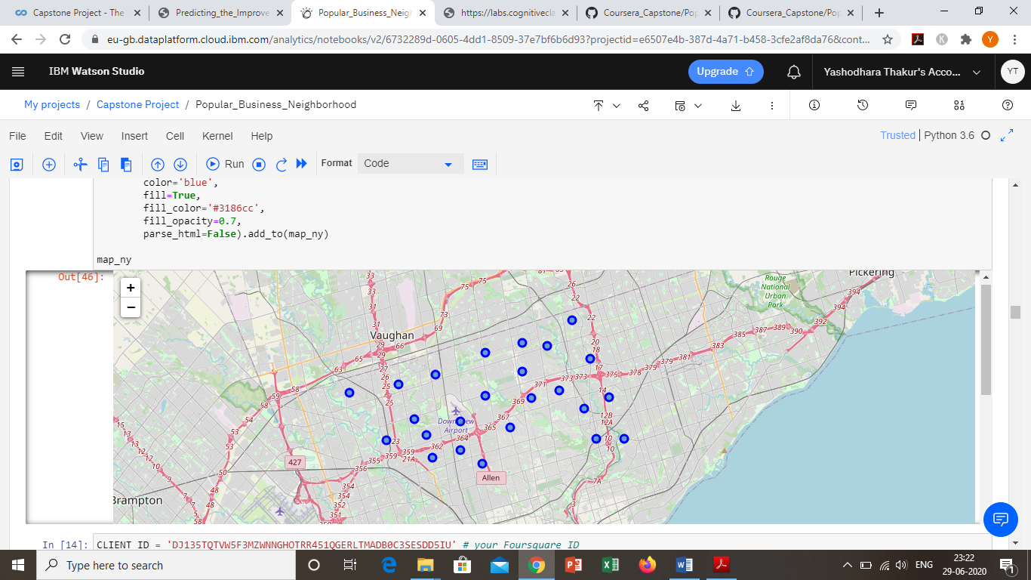
North York map
I also created a clusterd map of “North York” for visual representation.

Slide 9
Further analysis
Now we wanted to find the best neighbourhoods in North York.
To do that I used foursquare. I used foursquare to get the venues for all the neighbourhoods. Once this was done I had to get the top 2 neighbourhoods with maximum venues
After computing the top 2 neighbourhoods were: [Fairview, Henry Farm, Oriole] and [Willowdale and Willowdale East].
Now we had to find the popular businesses in these neighbourhoods.

Slide 10
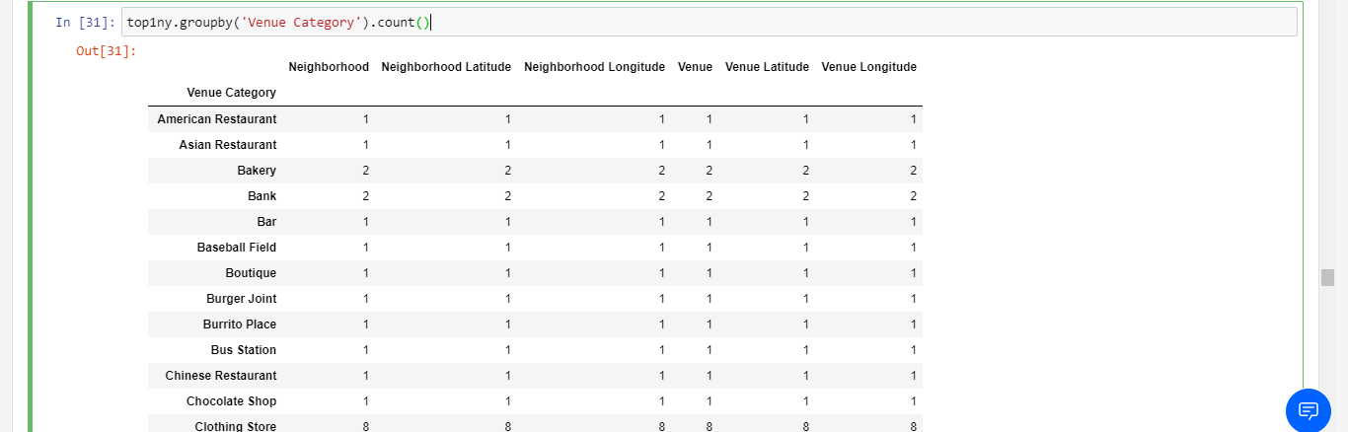
To find popular businesses in the neighborhood
To do that we first made 2 dataframes which consist the information of these 2 neighbourhoods and then grouped them according to the “Venue Category”, which looked something like this

Slide 11
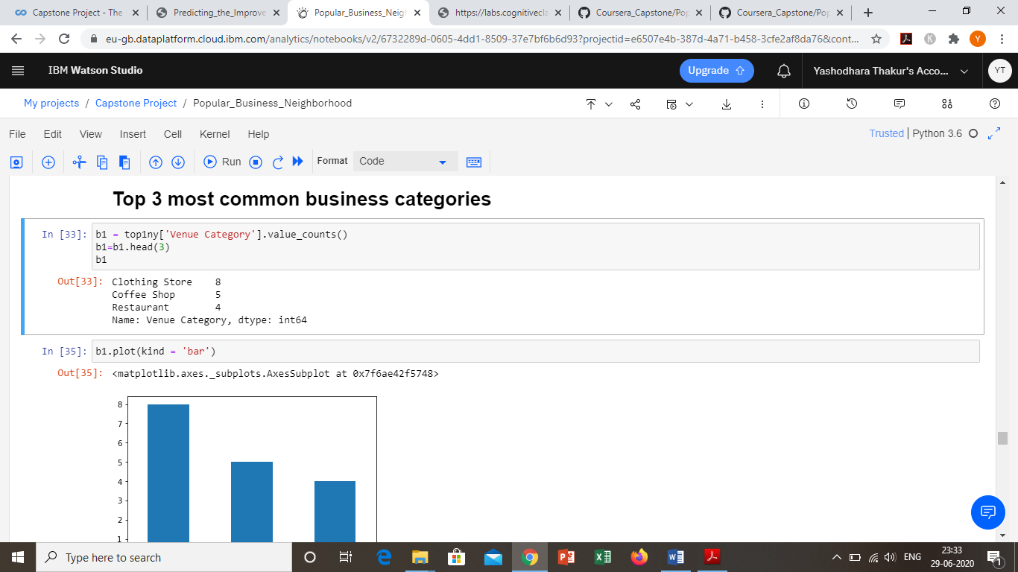
Results
Now we analysed the data to find the Top 3 most common business categories .The example of the output is shown below

Slide 12
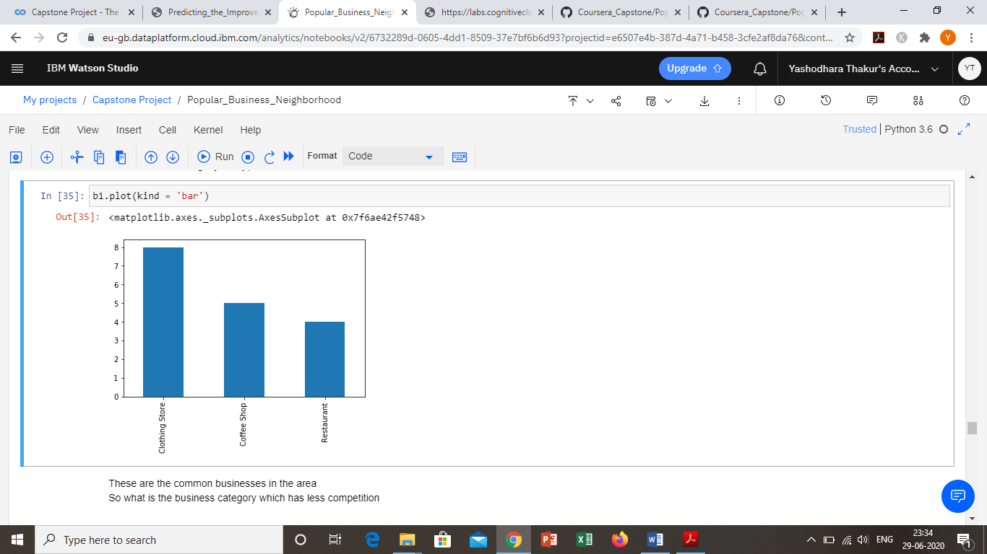

Slide 13
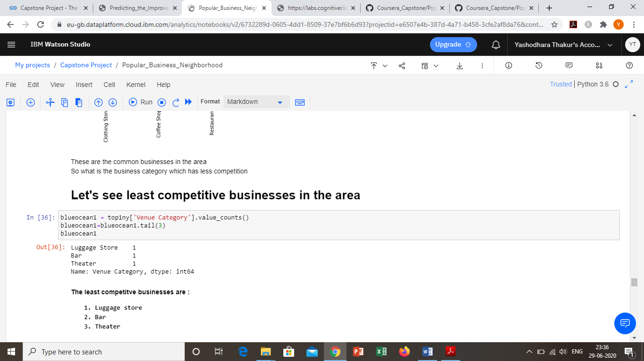

Slide 14
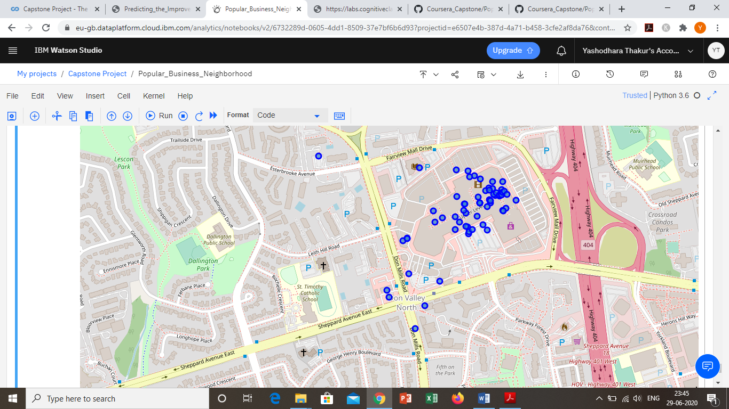
Now at last we append both the datasets as one to find the best neighbourhood cluster for business and plot it on the map as shown below

Slide 15
Conclusion and Further Direction
In this study, I analysed the different neighbourhoods in the city of Toronto.
Also analysed the popular boroughs and in those boroughs we further analysed the neighbourhoods
We further analysed these neighbourhoods to find the best neighbourhood to start a business.
. Not only that we also found out the most competitive and the least competitive local business categories in these neighbourhoods.
This model will be very helpful for people who want to start their own business and want to do competitive analysis
I have prepared this model on the basis of neighbourhoods / boroughs for a particular city. In future this model can be used to find the best city to start a business as well as a best country.
Also further competitive analysis is possible using this model by adding and analysing the current businesses information

